Slide 1

Media and Camera API working with Video and Audio Input
Steve Sherry Andrews
RA1911001010007

Slide 2
API: Application programming interface
This defines how the two components communicate with each other using requests and responses.

Slide 3
Media API working with Video and Audio Input
The MediaDevices.getUserMedia() method prompts the user for permission to use a media input which produces a Media Stream with tracks containing the requested types of media.
Stream can include a video track, an audio track or both together.
It returns a Promise that resolves to a MediaStream object. If the user denies permission, or matching media is not available, then the promise is rejected with NotAllowedError or NotFoundError

Slide 4
Generally, you will access the MediaDevices singleton object using navigator.mediaDevices, like this:
async function getMedia(constraints) { let stream = null; try { stream = await navigator.mediaDevices.getUserMedia(constraints); /* use the stream */ } catch (err) { /* handle the error */ } }

Slide 5
Constraints in Media API:
The constraints parameter is an object with two members: video and audio, describing the media types requested. Either or both must be specified. If the browser cannot find all media tracks with the specified types that meet the constraints given, then the returned promise is rejected with NotFoundError DOMException
getUserMedia({ audio: true, video: true })

Slide 6
Camera API with Audio and Video input
The Android framework includes support for various cameras and camera features available on devices, allowing you to capture pictures and videos in your applications.
The Android framework supports capturing images and video through the android.hardware.camera2 API or camera Intent.
Considerations:
Camera Requirements
Quick Picture or Customized Camera
Foreground Services Requirement
Storage

Slide 7
Manifest declarations
Camera Permission - Your application must request permission to use a device camera
Camera Features - Your application must also declare use of camera features.
Storage Permission - Your application can save images or videos to the device's external storage.
Audio Recording Permission - For recording audio with video capture, your application must request the audio capture permission.
Location Permission - If your application tags images with GPS location information, you must request the ACCESS_FINE_LOCATION permission.

Slide 8
Camera API
Mobile Application Development
Praveen Kumar

Slide 9

What is the Camera API
The Android framework includes support for various cameras and camera features available on devices, allowing you to capture pictures and videos in your applications. This document discusses a quick, simple approach to image and video capture and outlines an advanced approach for creating custom camera experiences for your users.
Capture Photos and Videos

Slide 10
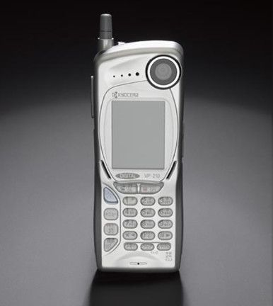
Camera API was introduces in Android along with Android version 1.0 (API 1)
Before being replaced by Camera2 API in 2014 which was launched in Android version 5.0 (API 5)

Slide 11
Permissions needed
Declare the permissions in the Android Manifest Camera Usage: android.permission.CAMERA" Camera Features: android.hardware.camera Camera Auto-Focus: android.hardware.camera.autofocus Write to External Storage: android.permission.WRITE_EXTERNAL_STORAGE

Slide 12
Camera API Overview
Primary API for controlling device cameras. Used to capture pictures and videos.
Package: android.hardware.Camera
Methods:
Camera.open() – Obtain an instance
startPreview() – Starts the Camera preview
takePicture() – Takes a picture
stopPreview() – Stops the Camera preview
release() – Releases the camera
getParameters() – Zoom, Image Quality, Location Information

Slide 13
Camera API – Features
Camera1 API
Detect and Access Camera
Create a Preview Class
Build a Preview Layout
Setup Listeners for Capture
Capture and Save Files
Release the Camera

Slide 14
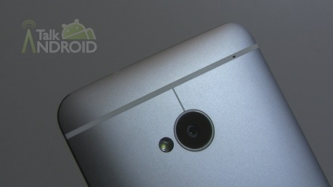
Camera API – Capture Photo Diagram
Camera Preview
surfaceCreated()
surfaceChanged()
surfaceDestroyed()
Activity
new CameraPreview(Camera)
Button Event Handler
Device Camera
Layout
FrameLayout and Button

Slide 15
New Features
Zoom (API level 8)
GPS Data
Video Snapshot (API level 14)
Face Detection (API level 14)

Slide 16
Camera2 API
Camera 1 is deprecated
Camera2 has some serious professional features for a camera app, and it's generally way faster compared to Camera1 when implemented right
API 21+ (>87%, as of July 2018) can benefit from it
But we have to make 2 logics (for devices not fully supporting and/or acting strange on Camera2)
Camera 2 works even when camera is not open.

Slide 17
Thank You

